Slide 1



Welcome to the “Next Step” – GSK live online career challenge
Find us on social media @digdatagroup
What will you need?
A good wi-fi connection
A notebook and pen
A quiet environment where you will not be disturbed for 40 minutes!
What do we expect?
Respectful and appropriate behaviour throughout this 40-minute briefing session
A positive attitude and a willingness to learn
There will be a number of opportunities throughout today’s presentation to ask questions using the chat function.
Please raise your hand if you need any assistance.
How will you benefit from completing this challenge?
The opportunity to solve GSK’s business problem
To learn about how your curriculum learning at school is used in the “real world”
Understand how valuable YOUR “Key skills” are when solving this problem and delivering the solution.
Gain a virtual work experience certificate
Any technical issues during this session – please email us on info@digdata.online

Slide 2
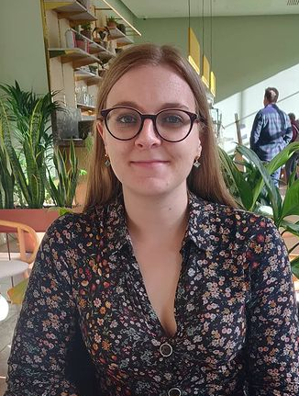
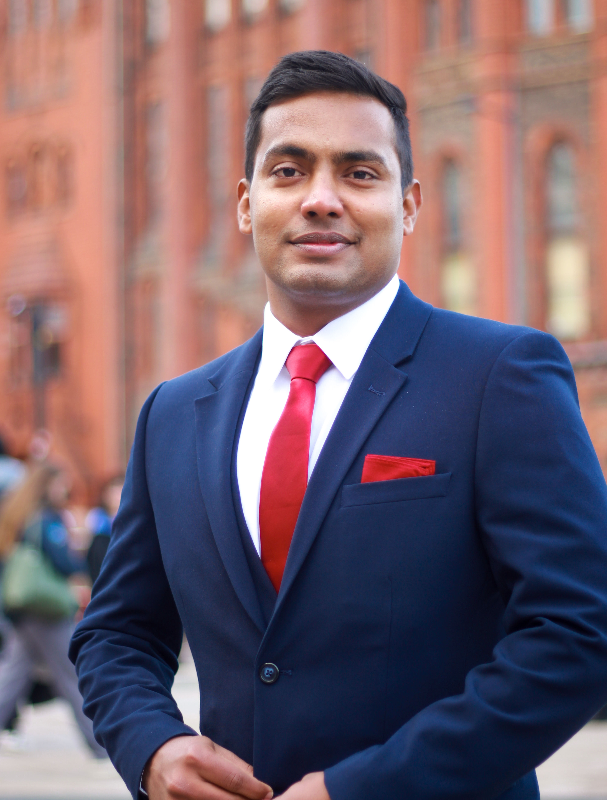

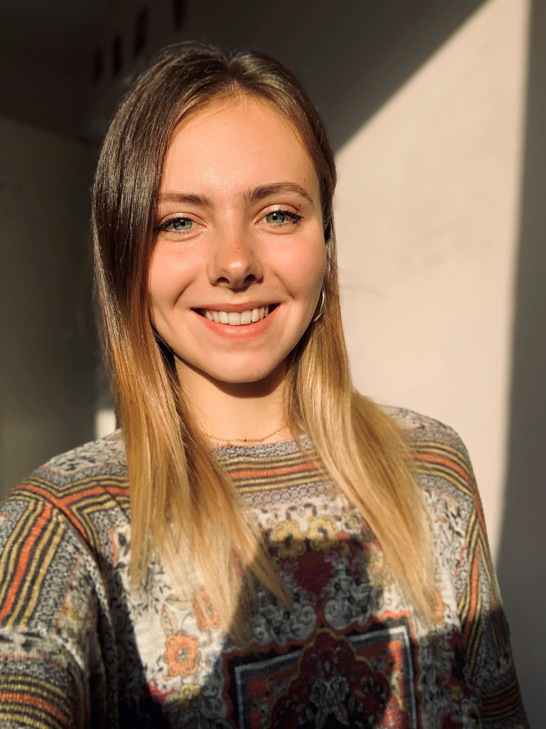
Meet the team
Alanah Jonas
Principal Data Scientist
Jishnu Prakash Kunnanath Poduvattil
Principal Data Scientist
Karima Ahmad
Data Science Degree Apprentice
Shannon Haughton
Programmer/
Analyst

Slide 3


Ice breaker time!

Slide 4
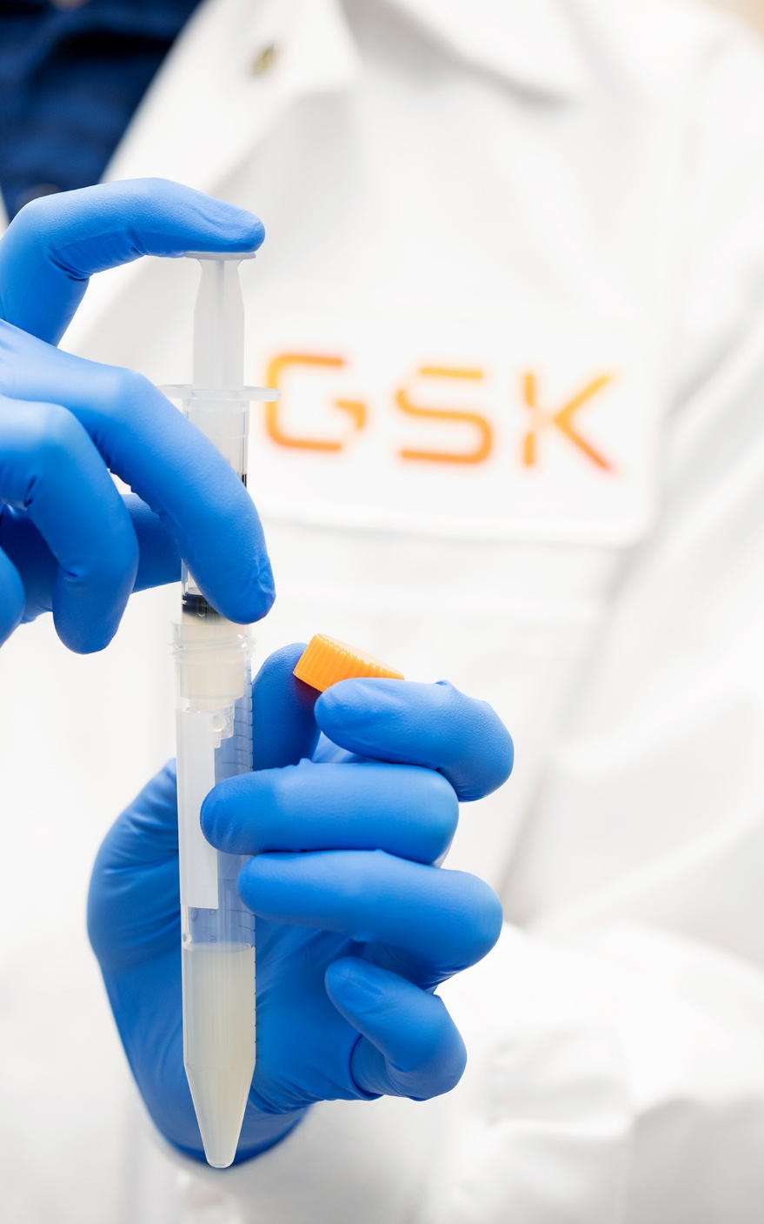

What year does GSK originate from?
A
B
C
1715
1903
2007
Many biopharma companies are made from legacy companies that join forces. GSK has a long history of mergers – the last of which happened in 2000!
Notes:
https://www.gsk.com/en-gb/company/history-and-heritage/

Slide 5

How many GSK vaccine doses do we deliver daily?
A
B
C
15,000
150,000
1,500,000
We have many marketed vaccines that help protect people around the world from a range of diseases & infections throughout their lives. Our vaccines protect millions from diseases like whooping cough, polio and measles.
Notes:
https://www.gsk.com/en-gb/products/our-product-areas/

Slide 6
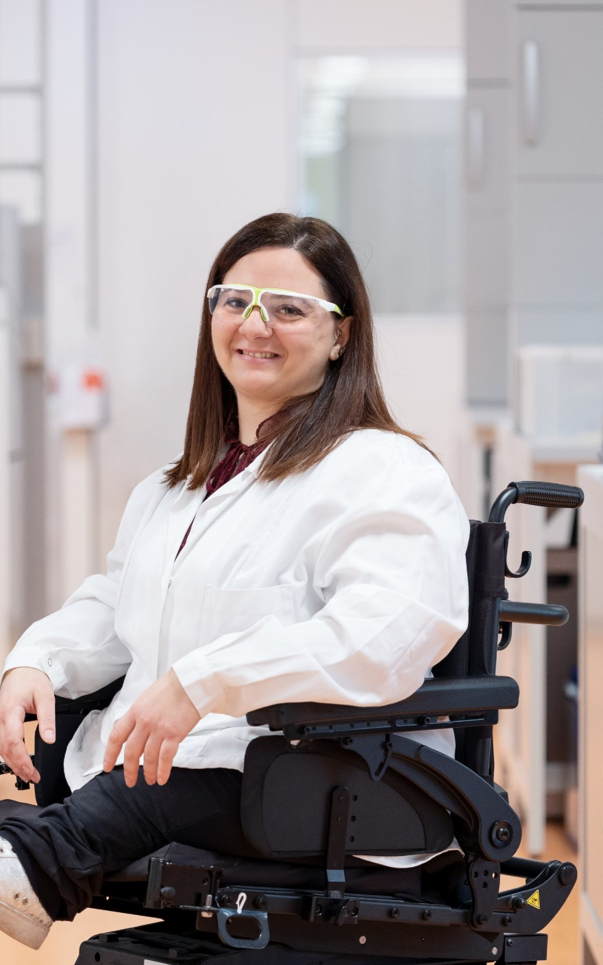
What percentage of children globally receive a GSK vaccine per year?
A
B
C
20%
30%
40%
Our vaccine portfolio is growing and we are proud of the impact our vaccines continue to have on the health of hundreds of millions of people around the world.
Notes:
https://www.gsk.com/en-gb/products/our-product-areas/

Slide 7
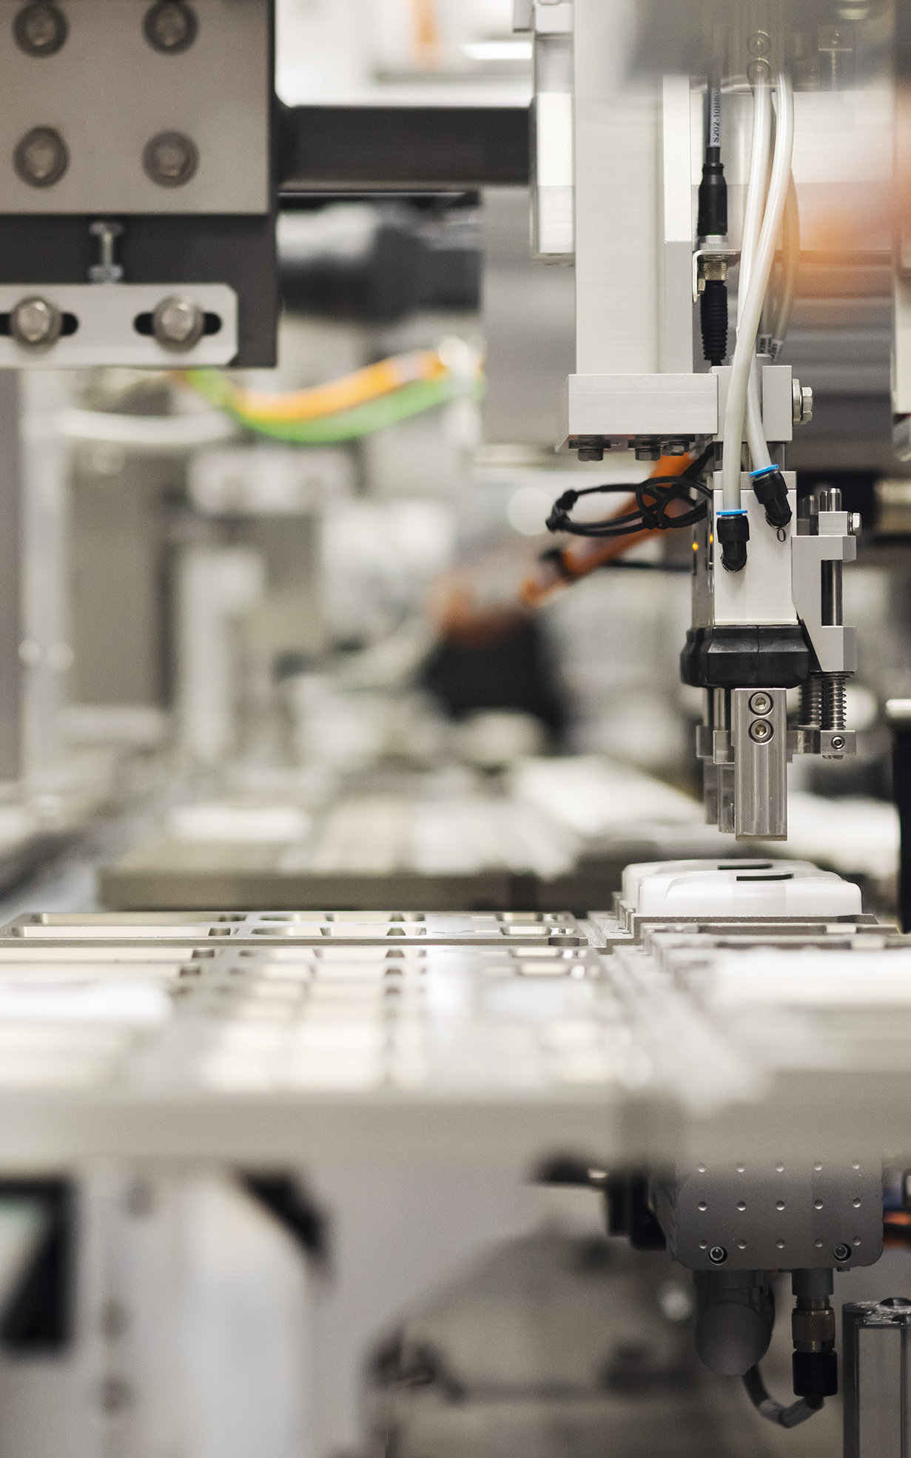
What are you hoping to learn from the Next Step Challenge ?
https://vevox.app/#/m/167712396
Poll Time
Notes:
Our product areas | GSK
We are keen to understand what you want to get out of the session, and will keep this poll open until 6.15pm to give you time to answer the poll and think about what you want to get out of this.
Please only include appropriate answers

Slide 8
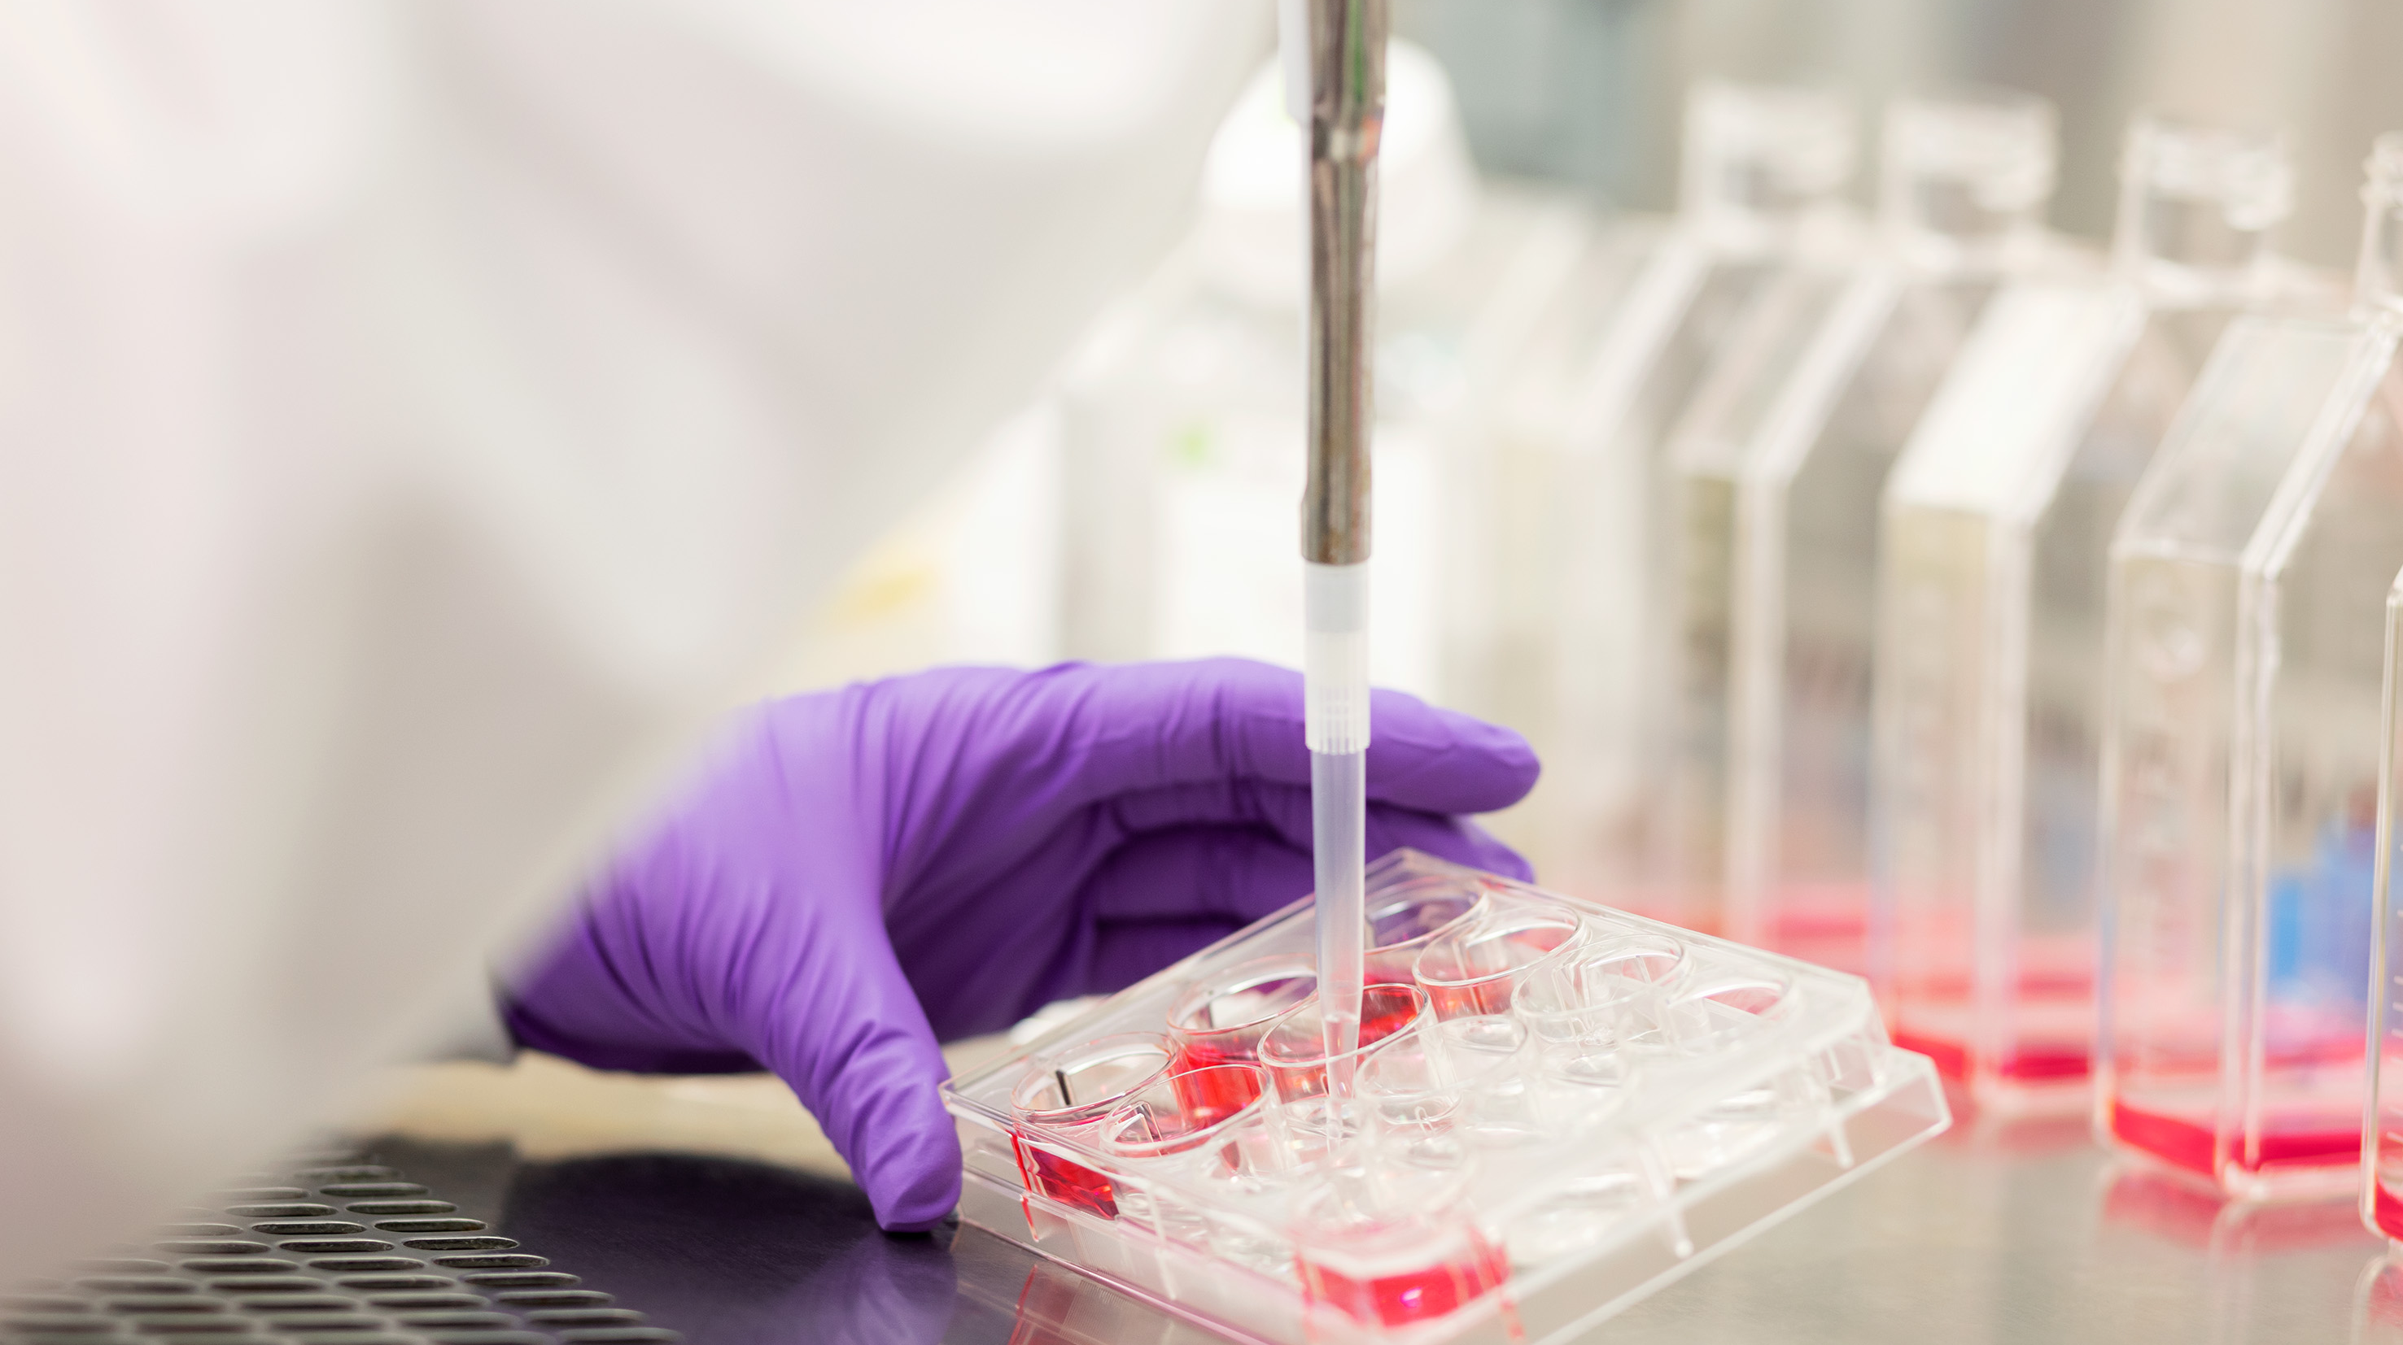
Who are GSK?
Notes:
So now we will just explain to you a bit about who we are as a company, but before we do, does anyone know anything about us already? Write your answers in the chat

Slide 9

Who are GSK?
One of the top ranking biopharma companies in the world
Develop medicines & vaccines to prevent & treat disease
Globally located in the US, Asia, Europe & the UK
Approximately 69,400 employees
Aim to positively impact the health of 2.5 billon people
Notes:
GSK are a biopharma company, meaning we develop medicines and vaccines to help treat various different conditions and diseases. We are a global company, with around 70,000 colleagues in the UK, US, Asia and the rest of Europe. And our main aim as a company is to positively impact the health of 2.5 billion people by 2030

Slide 10

What do we use data for at GSK?
Notes:
Another question to you all is what do you think we use data for at GSK?

Slide 11
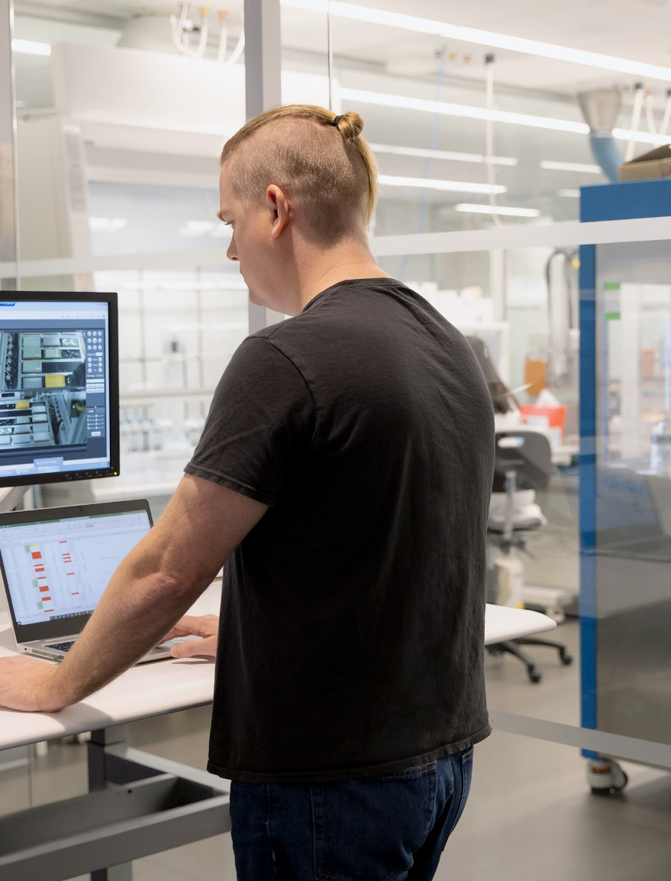




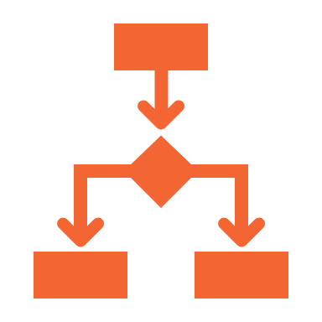

What do we use data for at GSK?
Data is a key asset for most companies, and GSK is no different
We generate new data by running new experiments
Analyses of these data help us make data-driven decisions
All our data is internally curated so that future analyses can provide new insight
Notes:
To develop medicines & vaccines we run experiments (in the lab & via clinical trials) on which we collect a huge amount of data. These data are used to help us make informed decisions about how to proceed next in development. Ultimately our data helps us to seek approval for a newly marketed treatment. We curate all of our data in-house, this huge amount of data is great for providing new insights that we can use to create new hypotheses and ultimately helps to designing new experiments in the pursuit of new medicines and vaccines

Slide 12












What tools & tech do we use?
We use a broad and growing range of tools and technologies at GSK. These cover:
Storing and accessing data
Version controlling code
Running analyses
Visualising data & results interactively
Tools for working effectively as an agile team
And many more!
Notes:
At GSK we use a variety of tools and technologies, some of which are shown on screen. We use these tools for a variety of things including storing data, running analyses, visualising the data and many more. But don’t worry if you have never used any of these tools in the past, our challenge is completely accessible just through the use of Microsoft excel, and we will provide you all the resources you need to do so. However, if you feel like you can use another tool to complete your work, for example you’re a budding python programmer, or you know a bit of SQL, as long as your results submission is as per the guidelines, feel free to explore and use other tools as you wish.

Slide 13
What is a Clinical Trial?
Notes:
So now we will explain a bit about clinical trials. Before we do, does anyone want to write in the chat what they know about clinical trials already?
Clinical Trials are used to assess the effects of a new treatment on human health outcomes. Clinical trials can be used to test a variety of different things from drugs to surgical procedures and medical devices.

Slide 14






Phase 1
Phase 2
Phase 3
Phase 4
Notes:
In-human clinical Trials are broken down into 4 phases:
Phase 1 where a small number of usually healthy volunteers take part
Phase 2 where the drug is tested on a group of people with the condition we are treating
Phase 3 where the treatment is tested on a larger group of people with the condition, and this is compared against either a placebo or an existing treatment to compare the effects
And finally phase 4 which is not always required for every medicine but can be where the treatment safety and side effects continue to be tested while the treatment is in use over time.

Slide 15






Inclusion
Exclusion
18-80 years of age
Pregnancy
Diagnosis of chronic heart failure
Smokers
Minors
Male
Notes:
When conducting a clinical trial the participants usually have to meet certain inclusion/exclusion criteria – also known as eligibility criteria. These allow the clinical trial to be conducted on a very specific group of participants. This allows the researchers to identify causal relationships between the treatment and the effects, rather than another factor intervening. For example if a clinical trial was being conducted on the effects of nicotine patches to aid participants in giving up smoking, but a participant was a non-smoker, we wouldn’t be able to gain meaningful insights from the trial.
Typical examples of inclusion criteria could be:
- An age group – for example 18-80 years of age
- A health condition you are trying to treat – for example chronic heart failure
- Male or Female
Typical examples of exclusion criteria could be:
- Other medical conditions than the one you are trying to treat – for example being pregnant
- Smokers
- Ethical considerations such as being a minor or unable to give consent

Slide 16
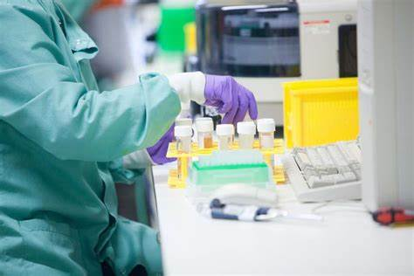
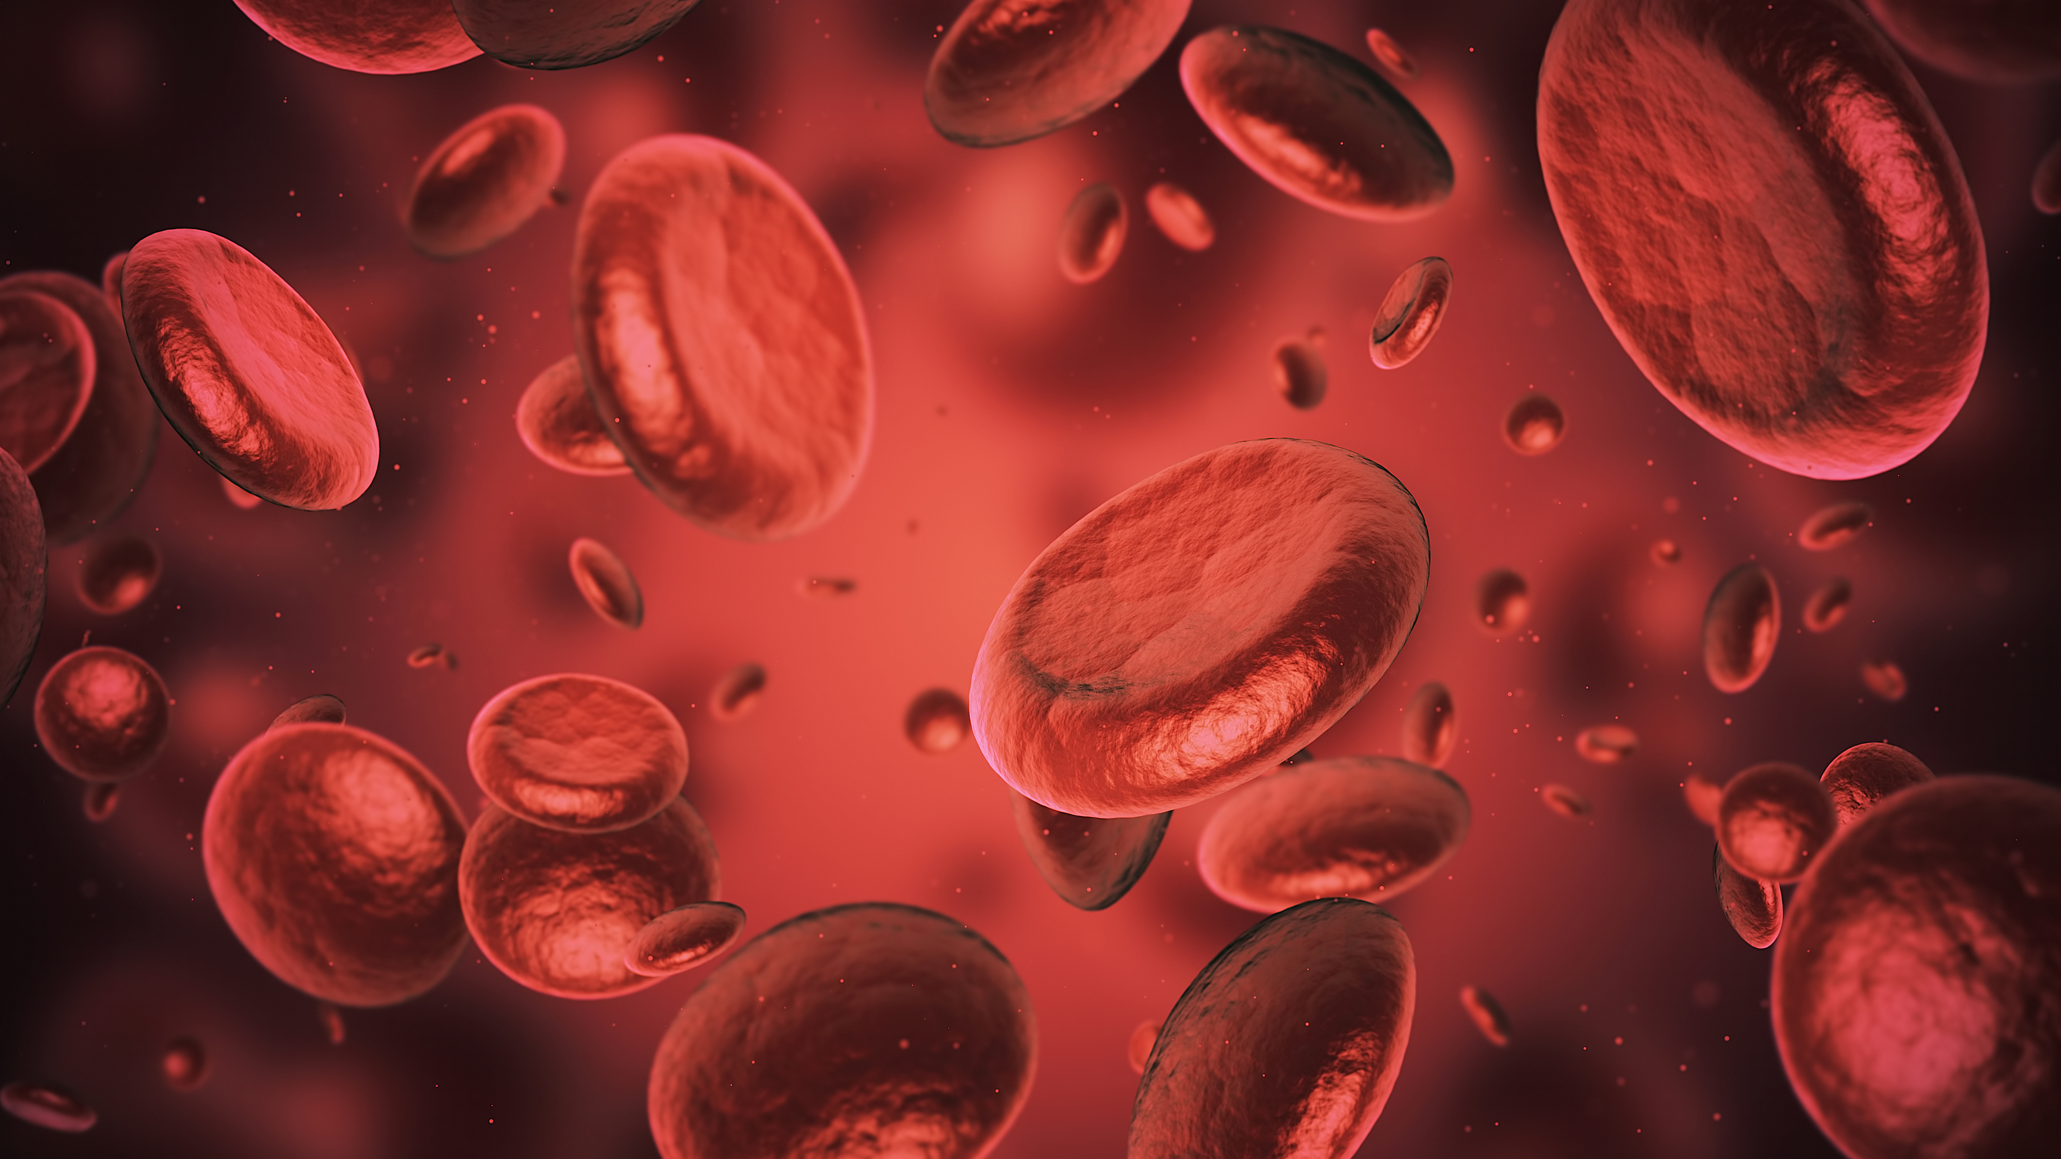
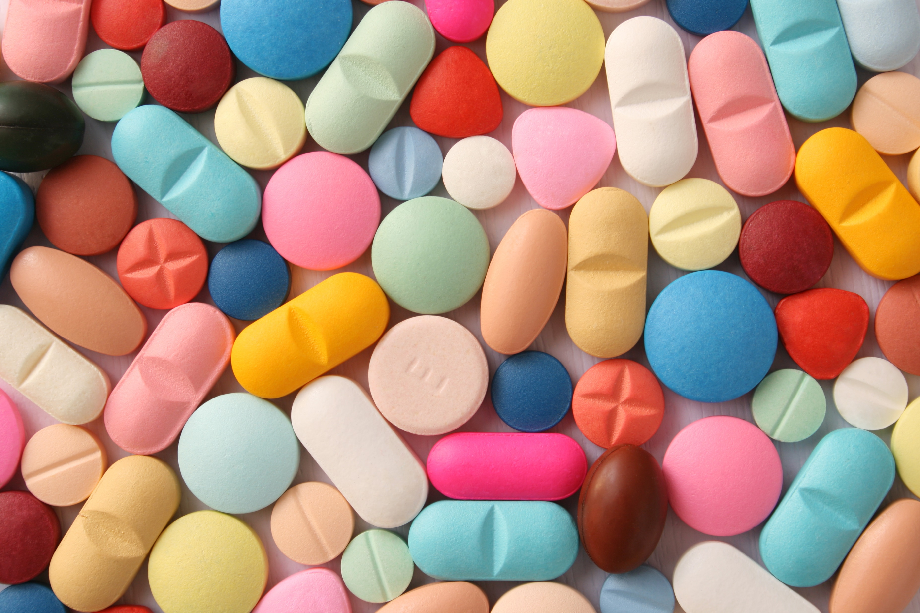
69 Vaccines and Medicines in development
3 Therapy Areas – Vaccines, Speciality Medicines and General Medicines
20+ Approvals since 2017
Notes:
At GSK we are conducting clinical trials every day. Our focus lies in 3 main therapy areas, Vaccines, Speciality Medicines including Cancer therapies, and General Medicines which include treatment for conditions such as asthma. We currently have 69 Vaccines and Medicines in development, and have had over 20 approvals for our treatments since 2017.

Slide 17

Challenge

Slide 18
Which hospitals should we chose to run our clinical trial?
Overview:
GSK are designing a study to test a new Flu vaccine on subjects. We need to recruit at least 200 subjects for our study. This subject data will help us to decide whether our vaccine progresses to the next stage of development. The GSK team need your help to select at least 2 hospitals to take our subjects from.
It is important to ensure that we only recruit subjects who meet our inclusion/exclusion criteria. This is so the subjects will be representative of the target population, and to ensure we can produce reliable and reproducible results. Therefore, we want to choose hospitals with the greatest number of subjects meeting these requirements.
Our Inclusion/exclusion criteria are as follows:
Aged 50 or above
Has a peak flow reading above 400 litres/min
Has not had a flu case or flu shot in the last 6 months
Does not have an egg allergy
Does not have a history of respiratory conditions
Has a BMI (Body Mass Index) between 18-32 kg/m2
Non-smokers only

Slide 19
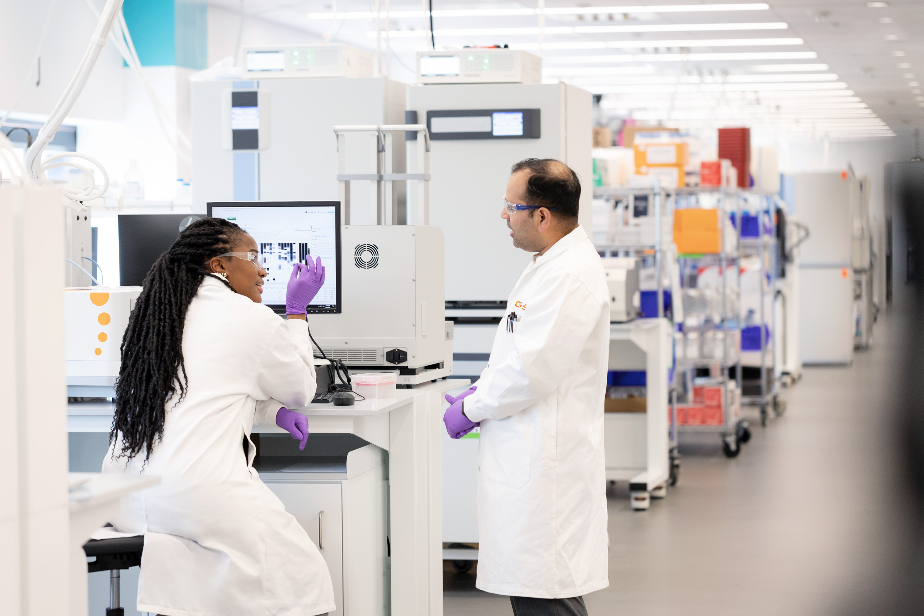
Which hospitals should we chose to run our clinical trial?
The challenge
We need your help to answer the following questions using our data:
What are the subject characteristics of each site?
Is the data accurate/reliable for each site?
Which hospitals should we chose to run our clinical trial?

Slide 20



Which hospitals should we chose to run our clinical trial?
Hints
What are the subject characteristics of each site? | Is the data accurate/reliable for each site? | Which hospitals should we chose to run our clinical trial?
What is the average age per site?
What is the proportion of males and females?
Are there any missing values?
How many subjects per site meet our inclusion exclusion criteria?
Are there repeated values?
What are the minimum and maximum values of age and BMI?
Any unrealistic values?
E.g. age>150 or age<0
What is the max peak flow rate for each subject?

Slide 21
Which hospitals should we chose to run our clinical trial?
The toolkit
We’ll provide you with:
A How-to-guide containing details on the challenge and the questions you should answer.
A dataset containing hospital and subject information.
An Excel cheat sheet, explaining how to do a variety of tasks in excel, such as creating summary statistics and data cleaning.

Slide 22
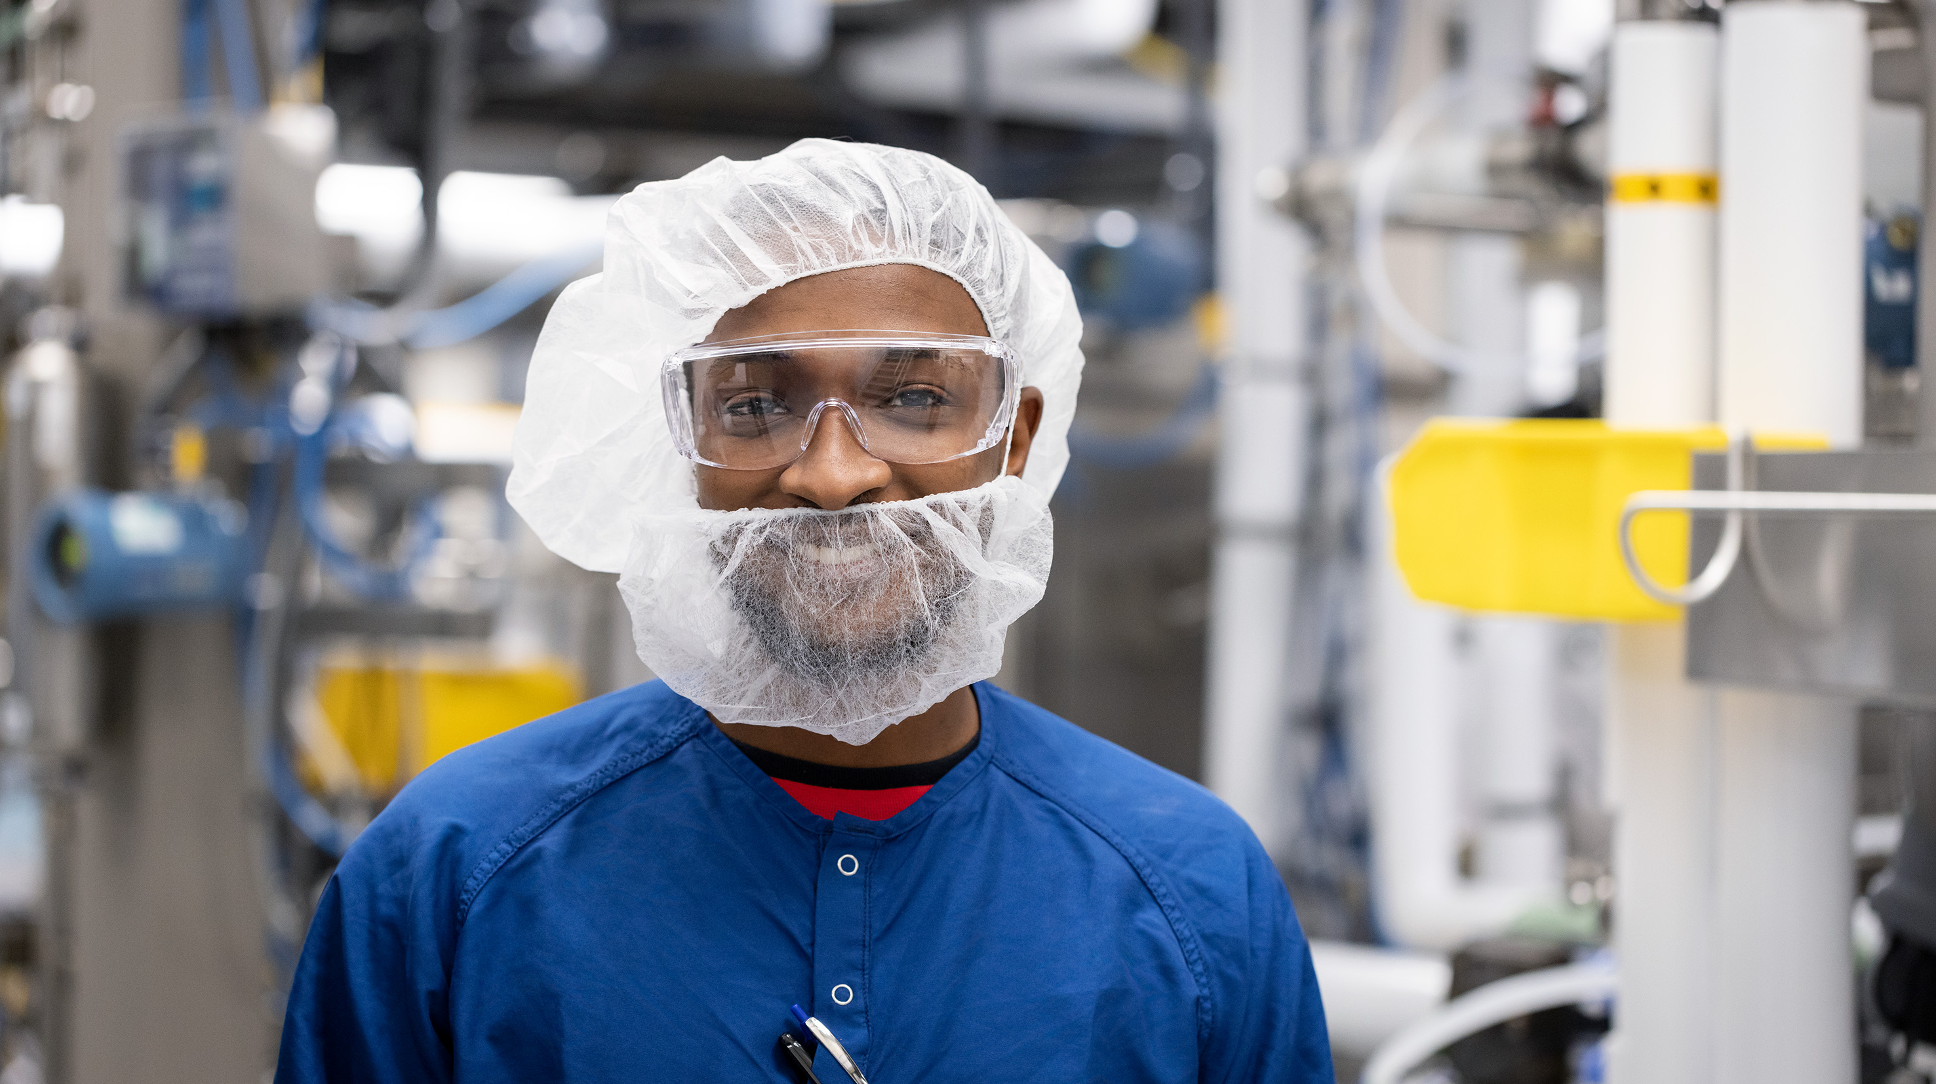
Any questions?

Slide 23
Our Data

Slide 24
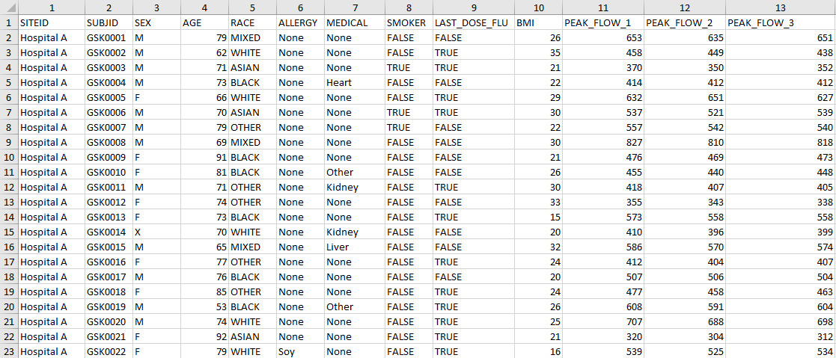
Overview of the data you’ll be given
The dataset contains 2284 rows of subject data, such as their sex, age, BMI and also the hospital are they associated with. There should be (hint!) one row per subject.
Don’t worry we don’t expect you to manually inspect every row! We'll show you how to explore a large dataset with ease in the excel cheat sheet PowerPoint.
Notes:
On the slide is a snippet of what the data will look like.
Our dataset contains information on just under 2300 rows. We have records of subject sex, age, BMI, etc. Each row should represent one subject (hint: check for duplicates).
Note: we know that there are lots of rows so we don't expect you to inspect each row manually – we have an excel cheat sheet in the form of a PowerPoint slide deck which demonstrates how to filter and explore data using a very small dataset as an example.
Talk through columns:
Under SITEID we have 5 sites (which are hospitals) to recruit from (Hospitals A, B C, D and E), each with a varying number of subjects.
These subjects are represented by an ID value under the second column SUBJID.
We expect the SEX column to contain either "M" or "F" and the AGE column to contain values ranging from 0 to 150.
So whether you decide to "clean" your data before analysis is up to personal discretion.
Each subject is categorised under a group for the RACE column, there are 6 groups of RACE.
We also have a information of the presence of any allergies or medical conditions the subjects may have, under the ALLERGY and MEDICAL columns.
The SMOKER column lists whether the subject has any history of smoking, recorded as TRUE or FALSE.
The LAST_DOSE_FLU represents whether the subject has been ill with the flu or taken a flu vaccine in the last 6 months, again these are TRUE or FALSE values.
BMI (body mass index) is a measure that uses height or weight to determine a numerical value that can be used to classify how healthy a subjects weight is (these are currently recorded as positive integers).
Lastly, we have 3 PEAK_FLOW columns – peak flow is a measurement of how quickly you can blow air out of your lungs, it also measures the degree of obstruction in the airways.
Each of the subjects have taken the peak flow test 3 times, so they each have 3 readings under the respective columns

Slide 25
What do the columns in the dataset tell you
Column | Type | Description
SITEID | Text | Unique ID value for each hospital
SUBJID | Text | Unique ID value for each subject
SEX | Text | Subject sex
AGE | Numeric | Subject age
RACE | Text | Subject race
ALLERGY | Text | Subject allergy information
MEDICAL | Text | History of medical conditions
SMOKER | Text (binary) | Is subject a smoker?
LAST_DOSE_FLU | Text (binary) | Has subject had the flu/a flu shot in last 6 months?
BMI | Numeric | Body mass index value
PEAK_FLOW_1 | Numeric | Peak flow reading 1
PEAK_FLOW_2 | Numeric | Peak flow reading 2
PEAK_FLOW_3 | Numeric | Peak flow reading 3
Note: “binary” in this case means the column contains one of two values, “TRUE” or “FALSE”
Notes:
Here a nice table which summaries the data type to expect for each column, as well as a brief description of what the columns mean
Just to note, the binary text type means the column contains either TRUE or FALSE

Slide 26
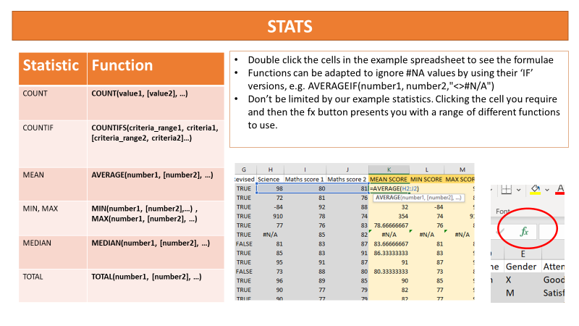
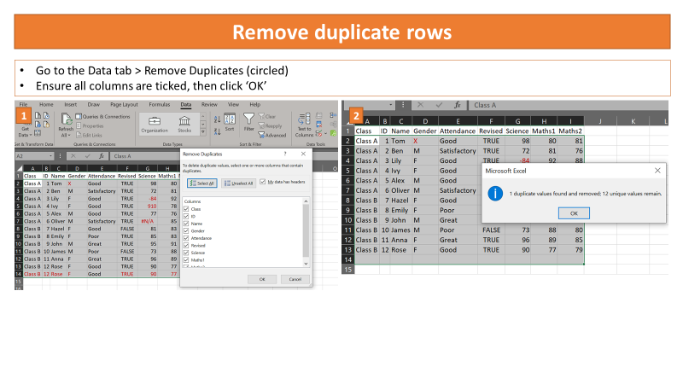
Excel cheat sheet (PowerPoint file)
We have prepared a PowerPoint slide deck which contains instructions on how to explore the data.
We use a small example dataset about students test scores to demonstrate each step.
This has been split into two sections:
1) How to create summary statistics
2) How to pre-process the data (clean and filter)
These slides are a supporting resource, so don't feel pressured to copy each step, and feel free to explore other methods of data pre-processing and analysis.
Notes:
Displayed are two screenshots from each section just as an example of what to expect.

Slide 27
Any questions?

Slide 28
Thank you!
Good Luck!

Slide 29
Find us on social media @digdatagroup
What happens now?
Digdata will send you:
Briefing document
Data set (Excel worksheet)
Hints & Tips fact sheet
Recorded session link
When is the GSK challenge deadline?
5.00pm on Wednesday 10th May
How can you present your solution?
Infographics
Graphs / charts
Code
Text / bullet points
Send all of your work to info@digdata.online and you will receive your virtual work experience certificate within 7 days.

